Slide 1

Travel Destination Website
St. Francis Institute of Technology
Department of Computer Engineering
Group Members
Jaimin Solanki 33
Rohan Tondlekar 39
Keegan Vaz 42
Alex Victor 43
Guide :- Dr. Kavita Sonawane
Notes:
‹#›

Slide 2

Content
Introduction
Problem Definition
Review of Literature
Proposed Model/Solution
Block Diagram/Architecture of Model
Hardware & software requirements
Social Impact of the System
Implementation Details
References
‹#›
Travel Destination Website
15/12/2020
Notes:
‹#›

Slide 3
Introduction
● People are always looking to visit a new travel destination to get a break from the daily routine. Most of the web searches directs them to famous places but those searches do not show the places with India’s rich culture and heritage which are dispersed in remote places of our country.
● Our website will be an ordered collection of all such dispersed places which would serve as a perfect guide and solution for travel enthusiasts and tourists.
● The state wise categorization of destinations would enable users to look for a unique places to visit in their desired state.
‹#›
Travel Destination Website
15/12/2020
Notes:
‹#›

Slide 4
Problem Definition
Most people in India look for travel destinations abroad without visiting the marvels of our country. This lowers our economy and discourages tourism in our country.
The reason why people travel abroad for a vacation is mostly because they are not aware of the rich cultural heritage and monuments that our country holds.
Our website will be an initiative to make people aware of such places.
‹#›
Travel Destination Website
15/12/2020
Notes:
‹#›

Slide 5
Review of Literature
We found two IEEE research papers, which were similar to our mini projects. One paper was based on Implementation of Tourism Business Web through which we got to know HTTP, XML, how MetaData is managed and Database is linked using API and Web services.
The Other Paper was based on Mountain Tourism Website Interface Design, which gave us a rough idea about how the User Interface and framework could be for a tourism website.
Our Mini Project will try to include the history, the authentic culture and the true essence of those places in our website to the best of the knowledge we could gather.
Travel Destination Website
15/12/2020

Slide 6
Proposed Model/Solution
This website was designed with the idea to make people both in India and abroad aware about the travel destination spots and monuments in India which are of huge cultural, spiritual and historical significance.
Most people are not aware of the our ancient culture and heritage which unfortunately got destroyed due to repetitive invasion in the past few centuries.
Our Mini Project is an initiative with the aim to gather as much information as possible about such places and be able to create a platform that would be useful to showcase such information to people make them aware of our marvels in the process.
Our website will also help with the growth of the tourism sector in India.
‹#›
Travel Destination Website
15/12/2020
Notes:
‹#›

Slide 7
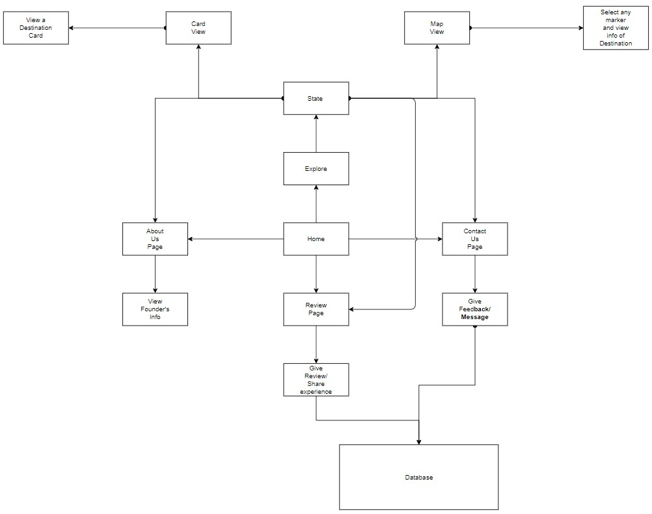
Block Diagram
Travel Destination Website
15/12/2020

Slide 8
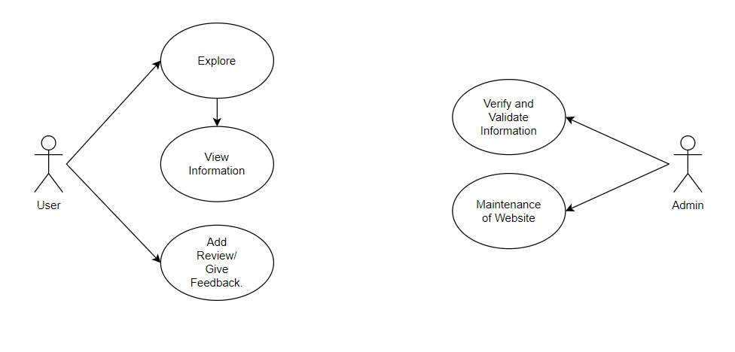
Use Case Diagram
‹#›
Travel Destination Website
15/12/2020
Notes:
‹#›

Slide 9
Hardware and Software Requirements
Hardware Requirements:
Desktop or laptop with at least an i3 processor, 2gb ram, and internet connectivity.
Softwares Used:
Visual Studio Code Editor
Google Maps API
XAMPP
GitHub
‹#›
Travel Destination Website
15/12/2020
Notes:
‹#›

Slide 10
Social Impact of the System
Our Mini Project will try to include the history, the authentic culture and the true essence of those places in our website to the best of the knowledge we could gather.
We have tried to include maximum data of such places.
Our mini project will try to develop a sense of pride among citizens, so that they could explore the Real Bharat upto its deep rooted ancient culture.
This will also help support the Tourism Industry in the country.
‹#›
Travel Destination Website
15/12/2020
Notes:
‹#›

Slide 11
Implementation Steps
1. Start
2. For User:
a. Open the website and if the user wants to see a travel destination then
the user should select Explore.
b. There India map Opens where user should select a state of their
choice.
c. After selecting the destination state user sees all the destinations
available in the state, where they select any destination and see its
history, speciality about the place and choose their holiday
destination .
d. User can also give review about the visited destination for future
visitors.
e. There's an Contact us button on the Home page where users can give
their valuable feedback for improvement of the website.
f. Users can also view the about us page and see our vision about the
website.
3. For admin:
a. Check the feedback regarding websites and make improvements in
the website
b. Also maintain the website with updated information and remove bugs
from the website.
4.Stop.
‹#›
Travel Destination Website
15/12/2020
Notes:
‹#›

Slide 12
REFERENCES
IEEE standard
Journal Paper:
S. Heripracoyo and S. Adi, "Implementation of Tourism Business Web," 2019 International Conference on Information Management and Technology (ICIMTech), Jakarta/Bali, Indonesia, 2019, pp. 30-35, doi: 10.1109/ICIMTech.2019.8843716.
R. Aryanto, A. Chang and M. H. Widianto, "Mountain Tourism Destination Website Interface Design Based on Classical Conditioning Theory of Persuasion," 2019 International Conference on Information Management and Technology (ICIMTech), Jakarta/Bali, Indonesia, 2019, pp. 461-465, doi: 10.1109/ICIMTech.2019.8843798.
Drive Link With State Wise Information
‹#›
Travel Destination Website
15/12/2020

Slide 13
Thank You
Travel Destination Website
15/12/2020

